Slide 1
Automation

Slide 2
Chris Blackden
DevOps Engineer at Center for Data Driven Discovery in Biomedicine (D3b Center) at Children’s Hospital of Philadelphia
Course Author at Pluralsight.com
Instructor at DevelopIntelligence.com
DevByAccident.com

Slide 3
Mise en place
1: A culinary process in which ingredients are prepared and organized (as in a restaurant kitchen) before cooking
Notes:
https://www.merriam-webster.com/dictionary/mise%20en%20place

Slide 4
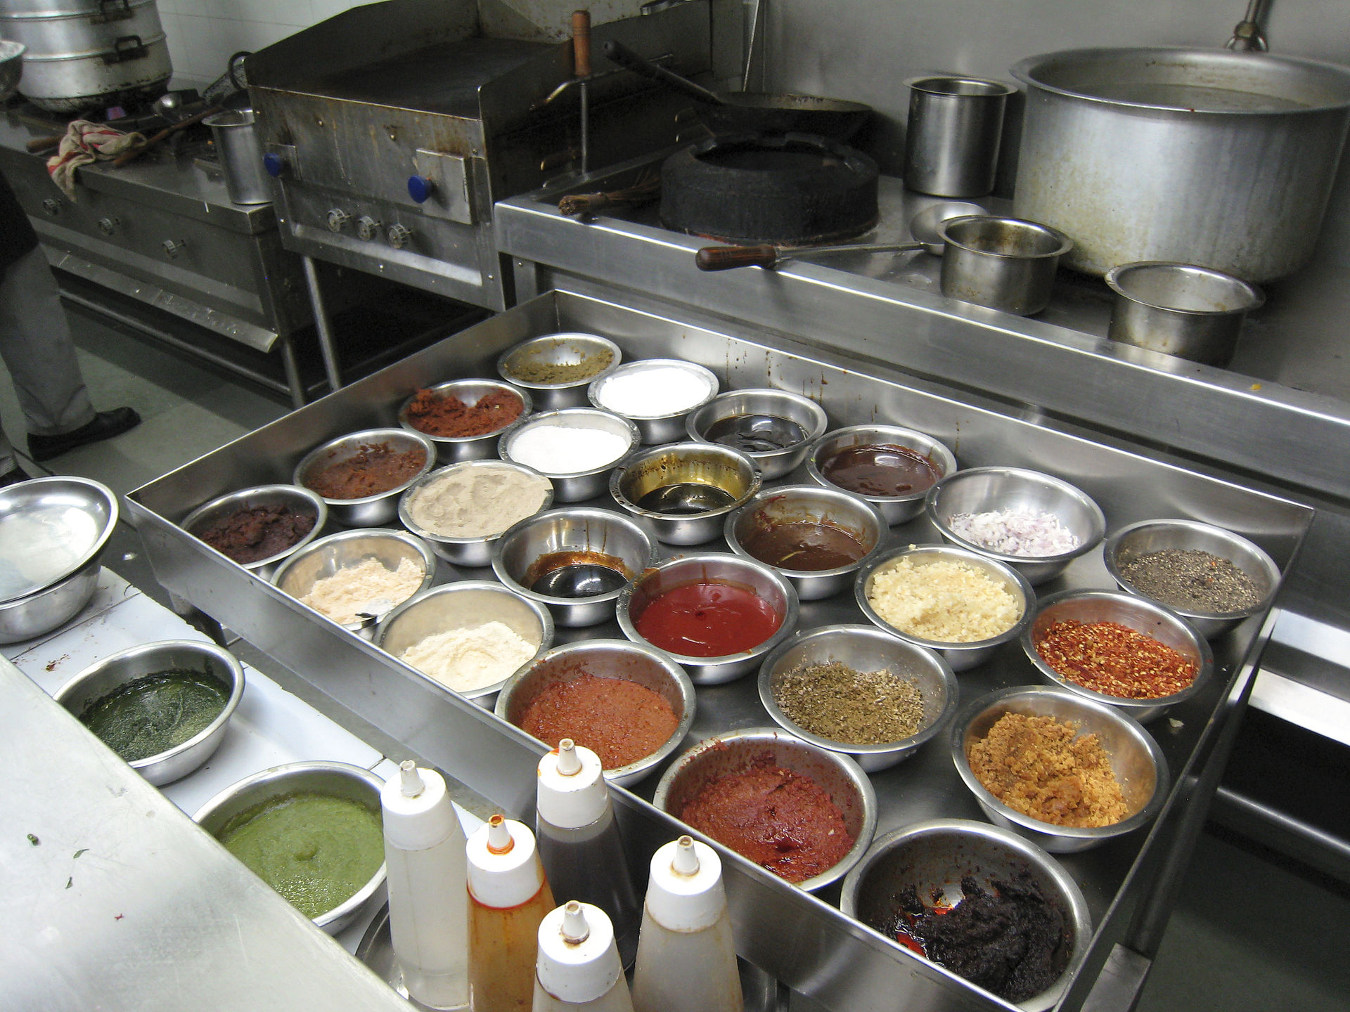
Mise en place for Software
Application Code
Unit Tests
Deployment
Configuration
Infrastructure as Code
Security and Compliance Requirements
Image Source: https://www.flickr.com/photos/haynes/500435491

Slide 5
Automation
1: The technique of making an apparatus, a process, or a system operate automatically
2: The state of being operated automatically
3: Automatically controlled operation of an apparatus, process, or system by mechanical or electronic devices that take the place of human labor
Notes:
https://www.merriam-webster.com/dictionary/automation

Slide 6
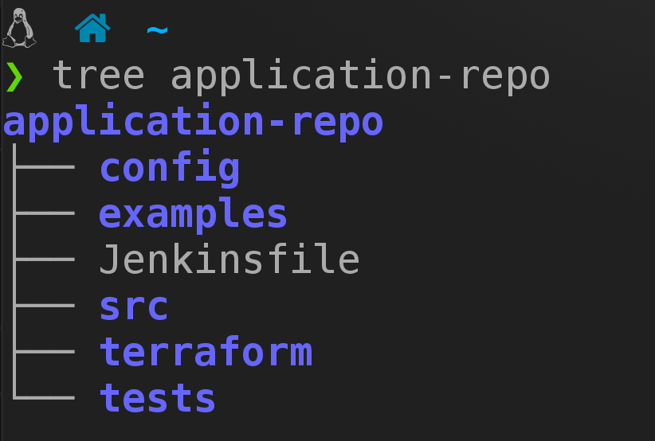
Why Automate?
Repeatability
Reduces human error
Improves visibility of processes
Enforces good practices
Lowers MTTR

Slide 7
Story Time - A DR event without automation
Lost a SCSI array in on-prem data center… And the 1,300 VMs on it
All data and config lost with VMs, application code in VCS
Spent two months re-provisioning servers, manually configuring application
Some configuration was never recovered
Stopped the entire department for over a month
Client hotfixes were delayed for a month

Slide 8
Story Time - A DR event WITH automation
Production instance deleted by script with too many privileges
Config, application code, and infra code in Git. Data in S3
terraform init && terraform apply
Production running in 5 minutes
“Be more careful next time.”
IAM role fixed

Slide 9
Demo

Slide 10
Related Courses
Implementing Terraform with Google Cloud Platform
Managing AWS Infrastructure with Python
Automation: Executive Briefing

Slide 11
https://github.com/devbyaccident/automation-talk

